Slide 1
PLANNING

Slide 2
Planning Domain Definition Language
PDDL = Planning Domain Definition Language
standard encoding language for “classical” planning tasks
Components of a PDDL planning task:
Objects: Things in the world that interest us.
Predicates: Properties of objects that we are interested in; can be true or false.
Initial state: The state of the world that we start in.
Goal specification: Things that we want to be true.
Actions/Operators: Ways of changing the state of the world.

Slide 3
Planning tasks specified in PDDL are separated into two files:
A domain file for predicates and actions.
A problem file for objects, initial state and goal specification.

Slide 4
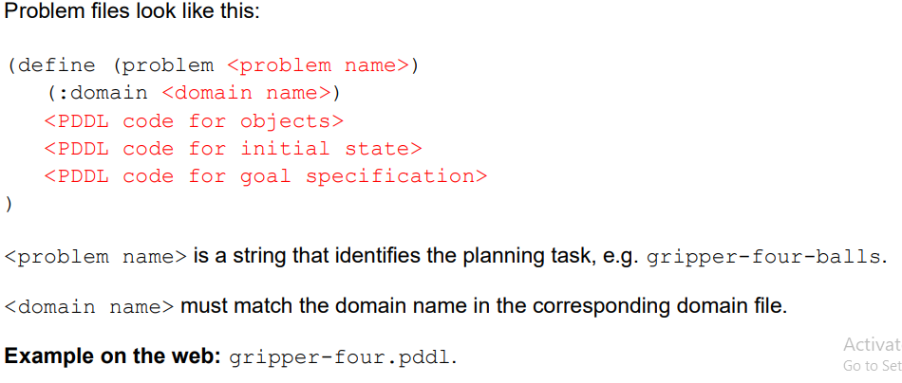
Problem Files

Slide 5
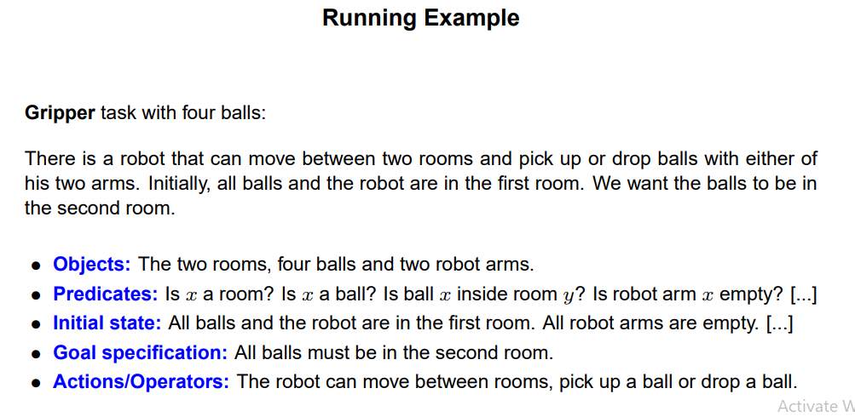

Slide 6
Air Cargo Transport
Air cargo is any shipment or items transported or carried via aircraft. It comprises air freight, airmail, and air express.
Air carriers may carry the cargo in passenger flights or cargo aircraft. Passenger aircraft put the spare volume in an airplane’s baggage hold (the belly) which is not in use for passenger luggage.
This is a usual practice followed by passenger airlines that transport air cargo on scheduled passenger flights.
A passenger aircraft may also act as a preighter, in which the complete passenger cabin is temporarily assigned for carrying freight.

Slide 7
How Does Air Cargo Shipping Operate?
Air cargo shipping consists of a complex network of airports, cargo planes, ground handling services, and logistics companies.
The air cargo shipping process begins with goods reaching an air cargo terminal, followed by a security screening.
After the necessary checks, the goods are stored and then loaded onto the aircraft.
This complicated process requires coordination among air carriers, ground services, and logistics providers to make the operations error-free and efficient

Slide 8
The detailed steps that facilitate the air cargo shipping process:
Finalising Booking: The first thing the shipper takes care of is booking the cargo with a preferred airline. The freight forwarder also provides the airline with all the necessary information about the origin, destination, and type of cargo.
Managing Paperwork: The freight forwarder or shipper prepares various documents like the bill of lading, commercial invoice, or other necessary certificates or permits involved in air cargo transportation.
Packaging and Labelling Cargo: The shipper packs the cargo and labels it as per the specifications of the respective airline, before shipping.
Cargo-Handling: As the cargo has the right labels and packaging on it, it’s ready for transport to the airport. On reaching the airport, the cargo is loaded either onto a specific cargo plane or placed in the cargo hold of a passenger plane for shipping.

Slide 9
Transporting Cargo: The aircraft then takes a flight to the destination airport. As soon as the plane lands, the concerned personnel unload the cargo and send it to the receiver’s destination.
Customs Clearance: Once the cargo hits the customs point, the customs duty officials pitch in to inspect and clear the cargo for entry into the destination country.
Delivery of Shipment: Finally, the airline or a local delivery service delivers the shipment to the recipient as it reaches the destination

Slide 10
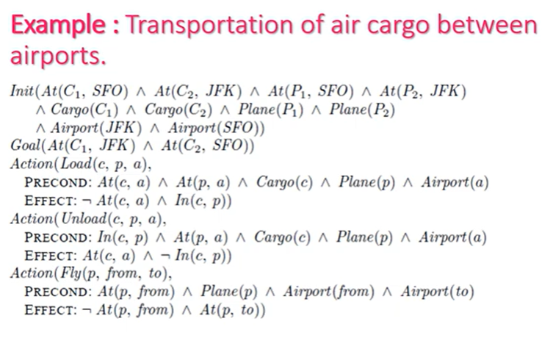

Slide 11
Benefits of Air Cargo Shipping
Speed and Efficiency: Air cargo is renowned for its speed, offering the quickest transportation method across long distances. This rapid transit time is crucial for industries relying on just-in-time manufacturing processes, emergency relief efforts needing urgent supply delivery, and businesses dealing in perishable goods or time-sensitive products like pharmaceuticals and fashion. The efficiency of air cargo reduces the reliance on large inventory stocks, allowing companies to operate on leaner supply chains with lower storage costs.
Global Reach: With air cargo, you can spread your wings across many destinations worldwide. It even becomes easy to access some remote and hard-to-reach areas by air. This extensive reach particularly benefits global businesses that need to expand their market presence or source materials from distant locations.

Slide 12
Safe Transit: The air cargo industry tends to maintain stringent security standards, which minimizes the risk of theft, damage, or loss during transit. Businesses or individuals wanting to ship high-value goods especially benefit from the enhanced security measures at airports, like surveillance, restricted access zones, and specialised handling. Owing to the secure environment and speedy delivery, businesses often prefer air cargo shipping for transporting their goods.

Slide 13
Drawbacks
Cost: One of the primary drawbacks of air cargo is its cost. The expense associated with air transport is significantly higher than other modes due to fuel consumption, aircraft maintenance, and airport fees. These costs often translate to higher freight charges, making air cargo less economically viable for low-value or high-volume shipments. Businesses must carefully weigh the benefits of quick delivery against the increased logistics costs.
Environmental Concerns: Eco-friendliness and sustainability are a huge concern when businesses opt for air cargo shipping because air transport is one of the most carbon-intensive modes of freight transport. It massively contributes to greenhouse gas emissions and global climate change. For example, the famous singer ‘Taylor Swift’ recently received backlash from the public for taking too many flights in her private jet. This is because it increases her carbon footprint and puts her in a bad light for hampering the environment.

Slide 14
Size and Weight Restrictions: Another drawback of taking this mode of transport is that an aircraft has finite space and payload capacity. Therefore, it imposes limitations on the size and weight of cargo eligible for transportation. These restrictions are a demerit for industries dealing in bulky or heavy goods, such as machinery or automotive parts. These heavy goods may need more space than allowed within the dimensional and weight constraints of standard air cargo services. It necessitates alternative logistics solutions for oversized shipments, which ends up potentially complicating the supply chain and increasing shipping costs.

Slide 15
Blocks World
The blocks world is a planning domain in artificial intelligence. The algorithm is similar to a set of wooden blocks of various shapes and colors sitting on a table.
The goal is to build one or more vertical stacks of blocks. Only one block may be moved at a time: it may either be placed on the table or placed atop another block.
Because of this, any blocks that are, at a given time, under another block cannot be moved. some kinds of blocks cannot have other blocks stacked on top of them.
Toy problems were invented with the aim to program an AI which can solve it. The blocks world domain is an example for a toy problem. Its major advantage over more realistic AI applications is, that many algorithms and software programs are available which can handle the situation.

Slide 16
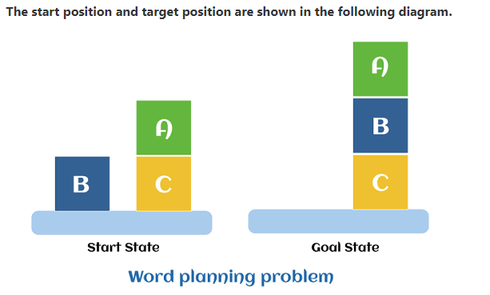
In its basic form, the blocks world problem consists of cubes in the same size which have all the color black. A mechanical robot arm has to pick and place the cubes. More complicated derivatives of the problem consist of cubes in different sizes, shapes and colors.
From an algorithm perspective, blocks world is an np-hard search and planning problem. The task is to bring the system from an initial state into a goal state.

Slide 17
Components of the planning system
The plan includes the following important steps:
Choose the best rule to apply the next rule based on the best available guess.
Apply the chosen rule to calculate the new problem condition.
Find out when a solution has been found.
Detect dead ends so they can be discarded and direct system effort in more useful directions.
Find out when a near-perfect solution is found.

Slide 18
Target stack plan
It is one of the most important planning algorithms used by STRIPS.
Stacks are used in algorithms to capture the action and complete the target. A knowledge base is used to hold the current situation and actions.
A target stack is similar to a node in a search tree, where branches are created with a choice of action.

Slide 19
The important steps of the algorithm are mentioned below:
Start by pushing the original target onto the stack. Repeat this until the pile is empty. If the stack top is a mixed target, push its unsatisfied sub-targets onto the stack.
If the stack top is a single unsatisfied target, replace it with action and push the action precondition to the stack to satisfy the condition.
iii. If the stack top is an action, pop it off the stack, execute it and replace the knowledge base with the action's effect

Slide 20
Problem Description
The Blocks World problem involves a set of blocks, each represented by a letter (e.g., A, B, C, D), and a flat table surface. The problem’s rules are relatively simple:
Blocks can be stacked on top of each other.
Only one block can be placed directly on top of another block.
To move a block that has other blocks stacked on top of it, you must first unstack the blocks above it until the desired block is free to move.
Blocks can also be placed directly on the table.

Slide 21
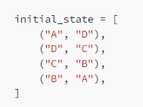
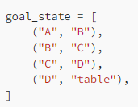
Objective
The primary objective of the Blocks World problem is to transform an initial configuration of blocks into a desired goal configuration by performing a series of legal actions.
Initial and Goal States
To illustrate the problem, let’s consider an example initial and goal state:
Initial State:
Goal State:

Slide 22
In this example, the initial state consists of four blocks (A, B, C, D) stacked in a particular order on top of each other. The goal state represents a different arrangement where the blocks are stacked from A to D in the same order, with block D placed on the table.

Slide 23
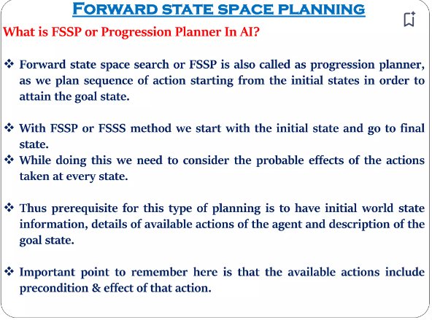

Slide 24
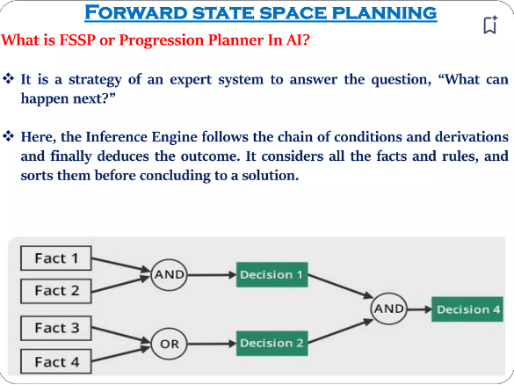

Slide 25
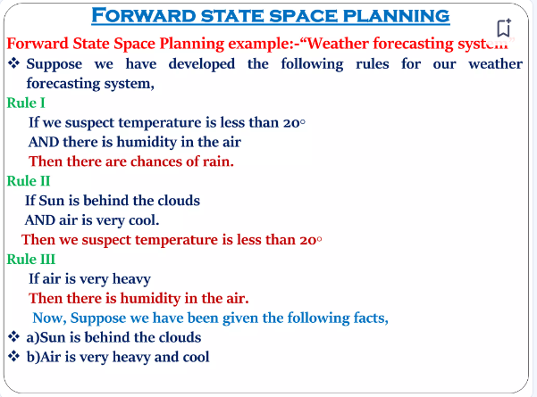

Slide 26
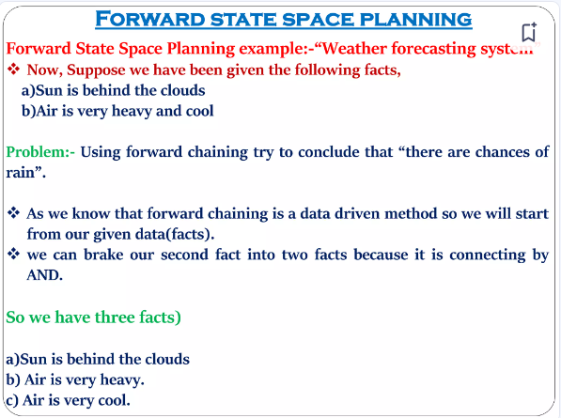

Slide 27
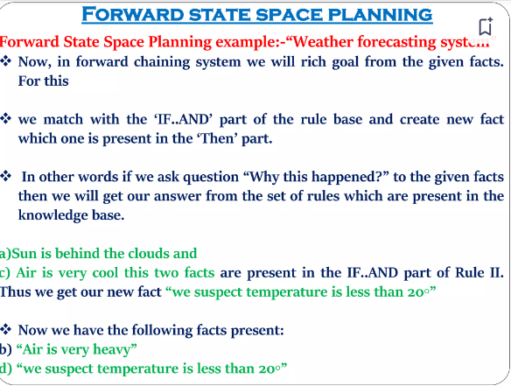

Slide 28
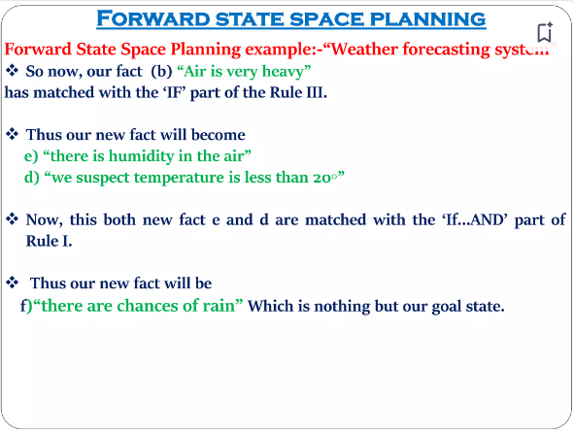

Slide 29
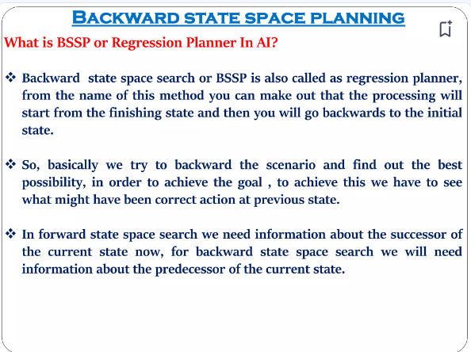

Slide 30
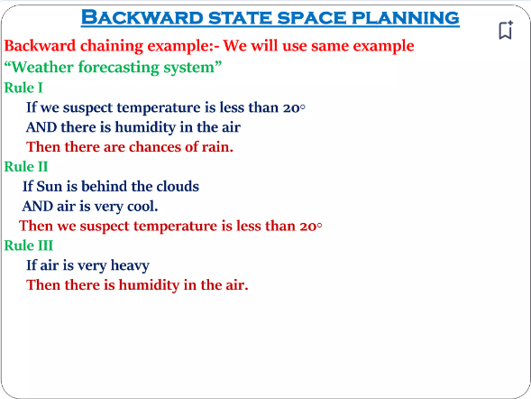

Slide 31
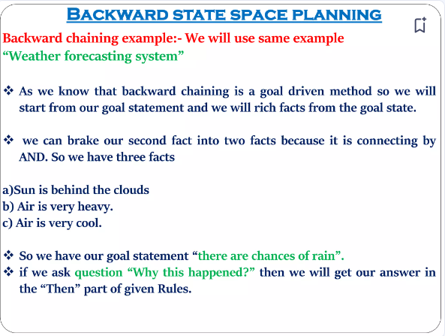

Slide 32
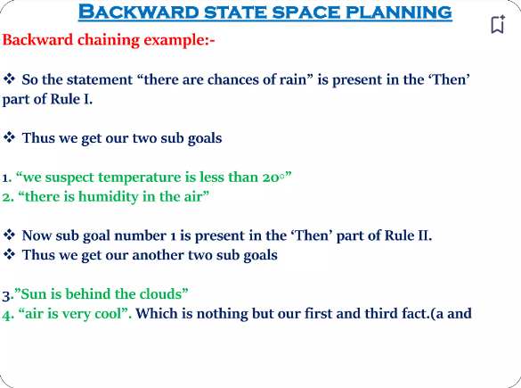

Slide 33
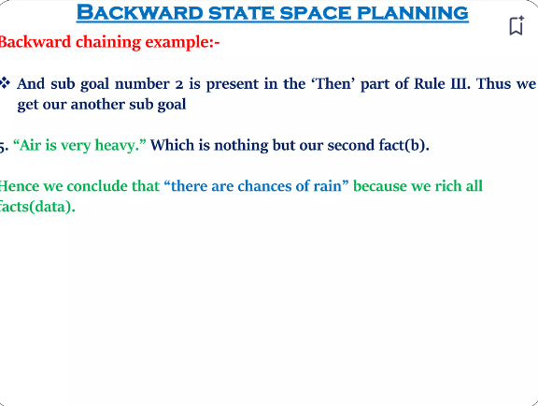

Slide 34
Classical Planning
In classical planning, we aren't constrained to symbols that only take on true or false values, as we were in propositional logic. Instead, we introduce objects that can represent things in our environment. We let predicates, also called propositions, be true or false functions over the objects.
A state is a conjunction of predicates. Similarly, our goal will also be a conjunction of predicates.
Operators change the state by adding or deleting predicates. An operator is defined by preconditions and effects. The preconditions specify all the predicates that need to be true in our current state in order for us to take this action. The effects are the predicates that we need to add or delete from our current state after we take this action. Notice that we do not explicitly represent time in classical planning, unlike the successor-state axioms in propositional logic. Important: there is a difference between deleting a predicate and adding its negation. We can require as a precondition the negation of a predicate, but we can’t require the absence of a predicate

Slide 35
Planning researchers use a factored representation
A state of the world stated in a collection of variables
PDDL: Planning Domain Definition Language
PDDL to define a search problem
Initial state
Actions available in the state
Result of applying an action
Goal test
States represented as conjunction of fluents
Representation carefully designed so that it is treated as a
Conjunction of fluents, manipulated by logical inference
Set of fluents, manipulated with set operations (set semantics sometimes easier to deal with)

Slide 36
States represented as conjunction of fluents
Representation carefully designed so that it is treated as a
Conjunction of fluents, manipulated by logical inference
Set of fluents, manipulated with set operations (set semantics sometimes easiear to deal with)
Actions
Described by a set of action schemas
Implicitly define ACTIONS(\(s\)) and RESULT(\(s,a\))
Needed to do a problem-solving search
The frame problem
Any system for action description needs to solve the frame problem
Specify what changes and what stays the same as result of an action
Classical Planning concentrates on problems where most actions leave most things unchanged
PDDL specifies the result of an action in terms of what changes, what remains the same is not mentioned

Slide 37
Means Ends Analysis
Means-Ends Analysis is problem-solving techniques used in Artificial intelligence for limiting search in AI programs.
It is a mixture of Backward and forward search technique.
The MEA technique was first introduced in 1961 by Allen Newell, and Herbert A. Simon in their problem-solving computer program, which was named as General Problem Solver (GPS).
The MEA analysis process centered on the evaluation of the difference between the current state and goal state.

Slide 38
How means-ends analysis Works:
The means-ends analysis process can be applied recursively for a problem. It is a strategy to control search in problem-solving. Following are the main Steps which describes the working of MEA technique for solving a problem.
First, evaluate the difference between Initial State and final State.
Select the various operators which can be applied for each difference.
Apply the operator at each difference, which reduces the difference between the current state and goal state.

Slide 39
Operator Subgoaling
In the MEA process, we detect the differences between the current state and goal state. Once these differences occur, then we can apply an operator to reduce the differences.
But sometimes it is possible that an operator cannot be applied to the current state.
So we create the subproblem of the current state, in which operator can be applied, such type of backward chaining in which operators are selected, and then sub goals are set up to establish the preconditions of the operator is called Operator Subgoaling.

Slide 40
Algorithm
Current state as CURRENT and Goal State as GOAL, then following are the steps for the MEA algorithm.
Step 1: Compare CURRENT to GOAL, if there are no differences between both then return Success and Exit.
Step 2: Else, select the most significant difference and reduce it by doing the following steps until the success or failure occurs.
Select a new operator O which is applicable for the current difference, and if there is no such operator, then signal failure.
Attempt to apply operator O to CURRENT. Make a description of two states. i) O-Start, a state in which O?s preconditions are satisfied. ii) O-Result, the state that would result if O were applied In O-start.
If (First-Part <------ MEA (CURRENT, O-START) And (LAST-Part <----- MEA (O-Result, GOAL), are successful, then signal Success and return the result of combining FIRST-PART, O, and LAST-PART.

Slide 41
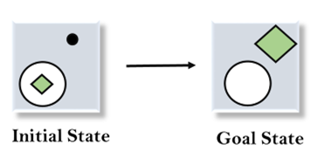
Example of Mean-Ends Analysis:
Let's take an example where we know the initial state and goal state as given below. In this problem, we need to get the goal state by finding differences between the initial state and goal state and applying operators.

Slide 42

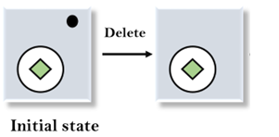
To solve the above problem, we will first find the differences between initial states and goal states, and for each difference, we will generate a new state and will apply the operators. The operators we have for this problem are:
Move
Delete
Expand
1. Evaluating the initial state: In the first step, we will evaluate the initial state and will compare the initial and Goal state to find the differences between both states.
2. Applying Delete operator: As we can check the first difference is that in goal state there is no dot symbol which is present in the initial state, so, first we will apply the Delete operator to remove this dot.

Slide 43
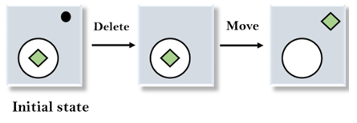
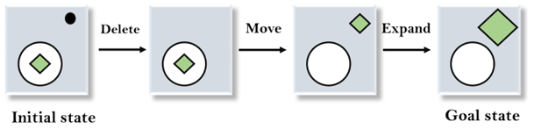
3. Applying Move Operator: After applying the Delete operator, the new state occurs which we will again compare with goal state. After comparing these states, there is another difference that is the square is outside the circle, so, we will apply the Move Operator.
4. Applying Expand Operator: Now a new state is generated in the third step, and we will compare this state with the goal state. After comparing the states there is still one difference which is the size of the square, so, we will apply Expand operator, and finally, it will generate the goal state.

